Slide 1
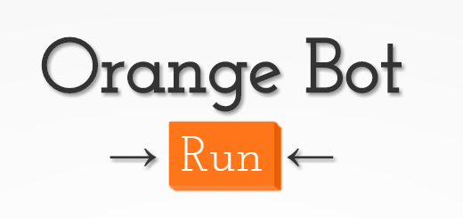

Slide 2
In order to create a bot that monitors Twitter for negative/positive Home Depot experiences, we used Twitter API to scan and get tweets related to Home Depot.
Then we implemented the IBM Watson Tone Analyzer to determine whether the tweet had a negative or positive feedback and then used the nodemailer API to send a report to a Home Depot attendant so they can contact the customer.

Slide 3
We used “twit,” a Twitter API client for node.
This allowed us to get specific tweets related to Home Depot and reply based on its positive or negative value.

Slide 4
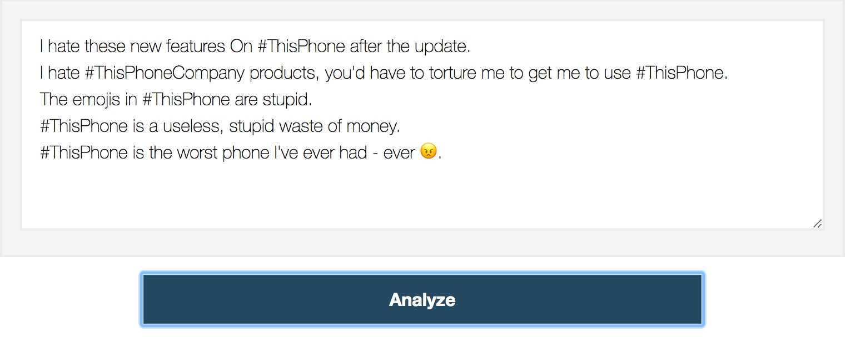
By analyzing the emotions/tones in customers’ tweets, we can predict whether the customer was satisfied with their service or not, and respond to their needs appropriately.
example

Slide 5
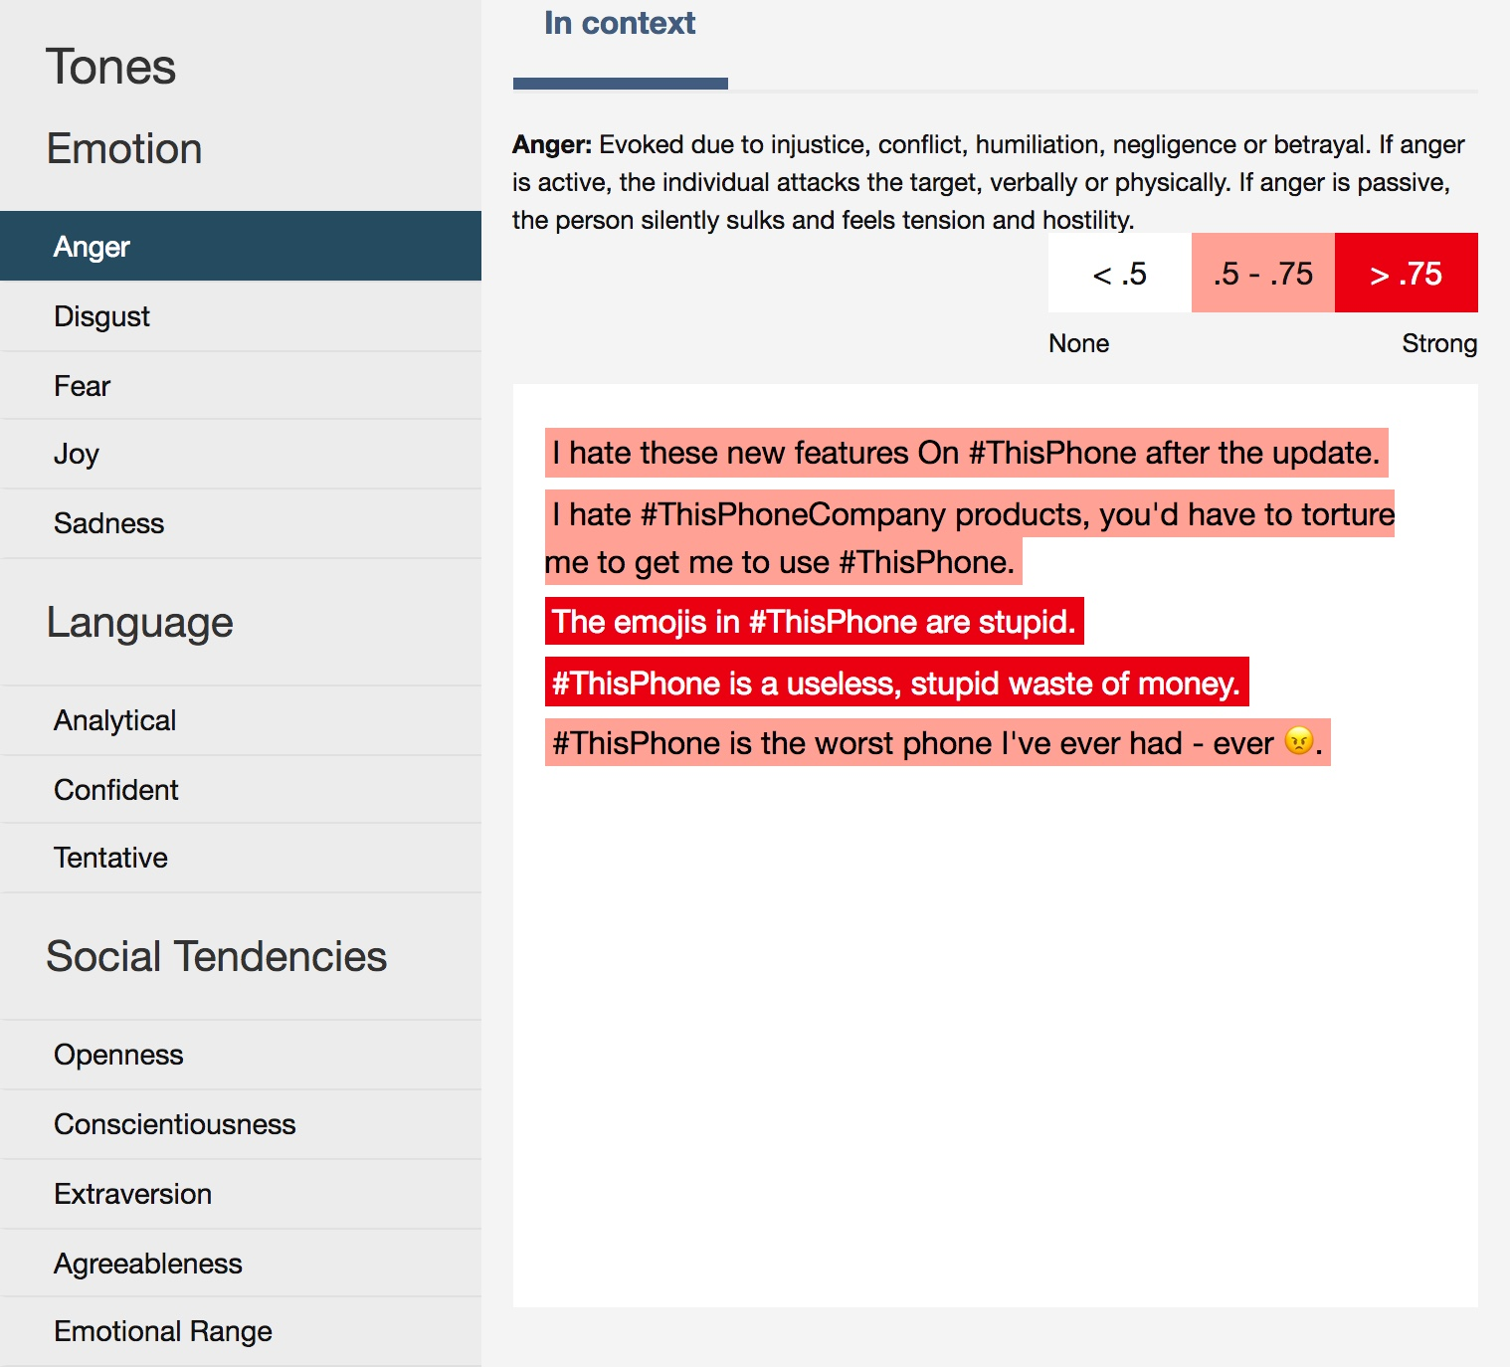
IBM Watson Tone Analyzer
This service uses linguistic analysis to detect and interpret emotions, social tendencies, and language style cues found in text.
Tones detected within the General Purpose Endpoint include:
Joy
Fear
Sadness
Anger
Analytical
Confident
Tentative
Openness
Conscientiousness
Extraversion
Agreeableness
Emotional Range

Slide 6
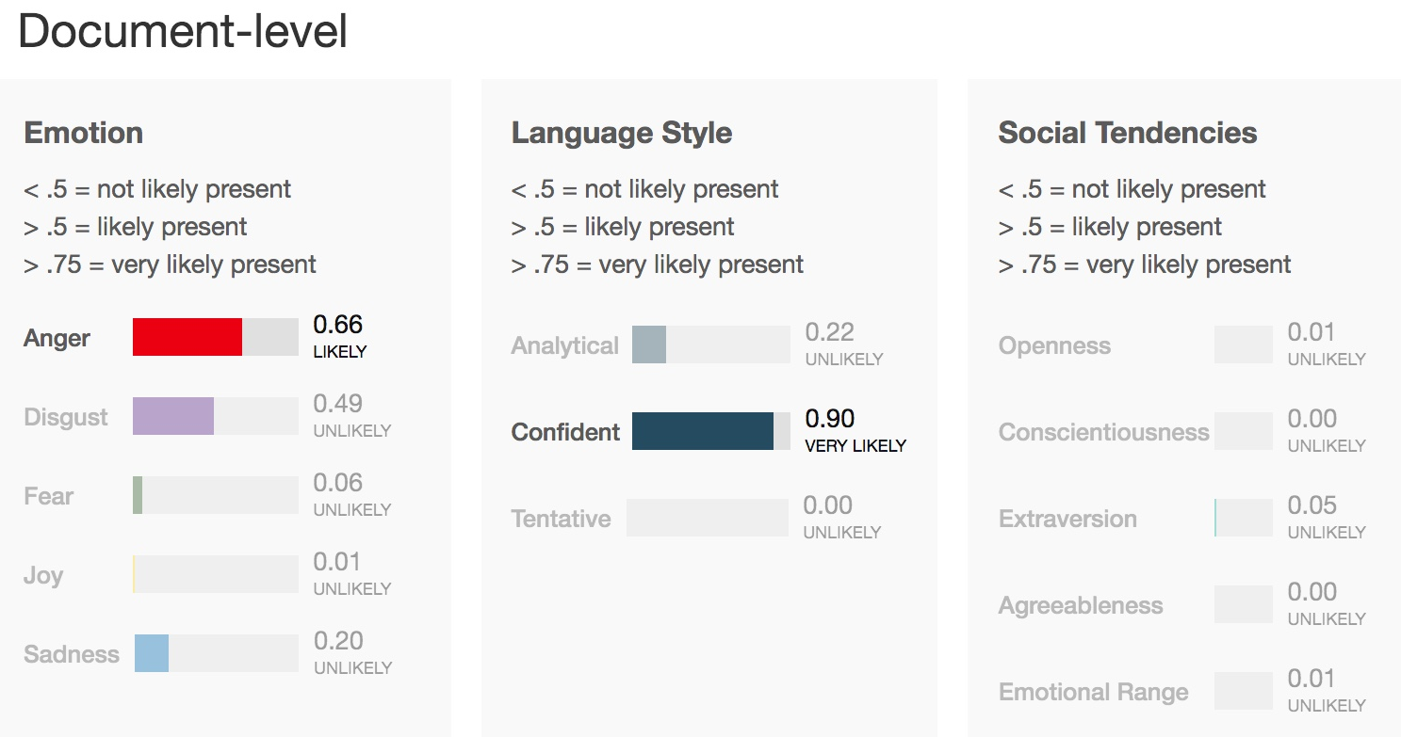

Slide 7
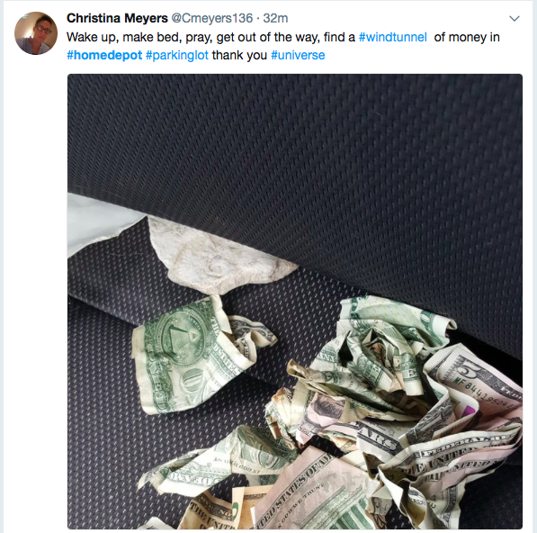
Positive Feedback
example

Slide 8
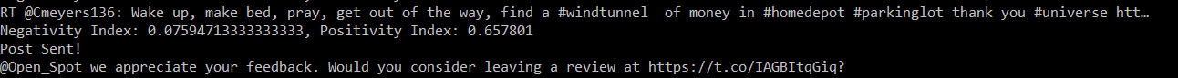
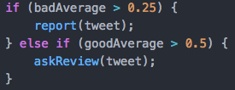
Bot Responding to Positive Feedback
Threshold when determining whether or not it's a positive or negative feedback

Slide 9
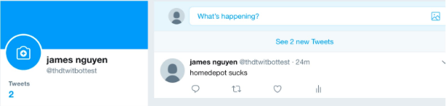

Bot Responding to Negative Feedback
Negative feedback about Home Depot
Sending an email to an Home Depot employee

Slide 10
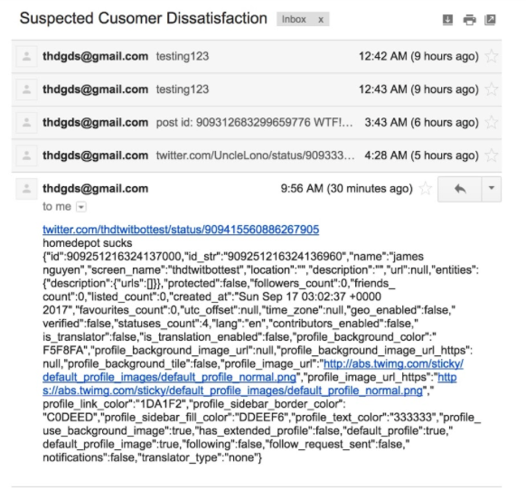
Example email sent to the Home Depot employee regarding negative feedbacks:
Includes a link to the post
Text of the post
User information

Slide 11
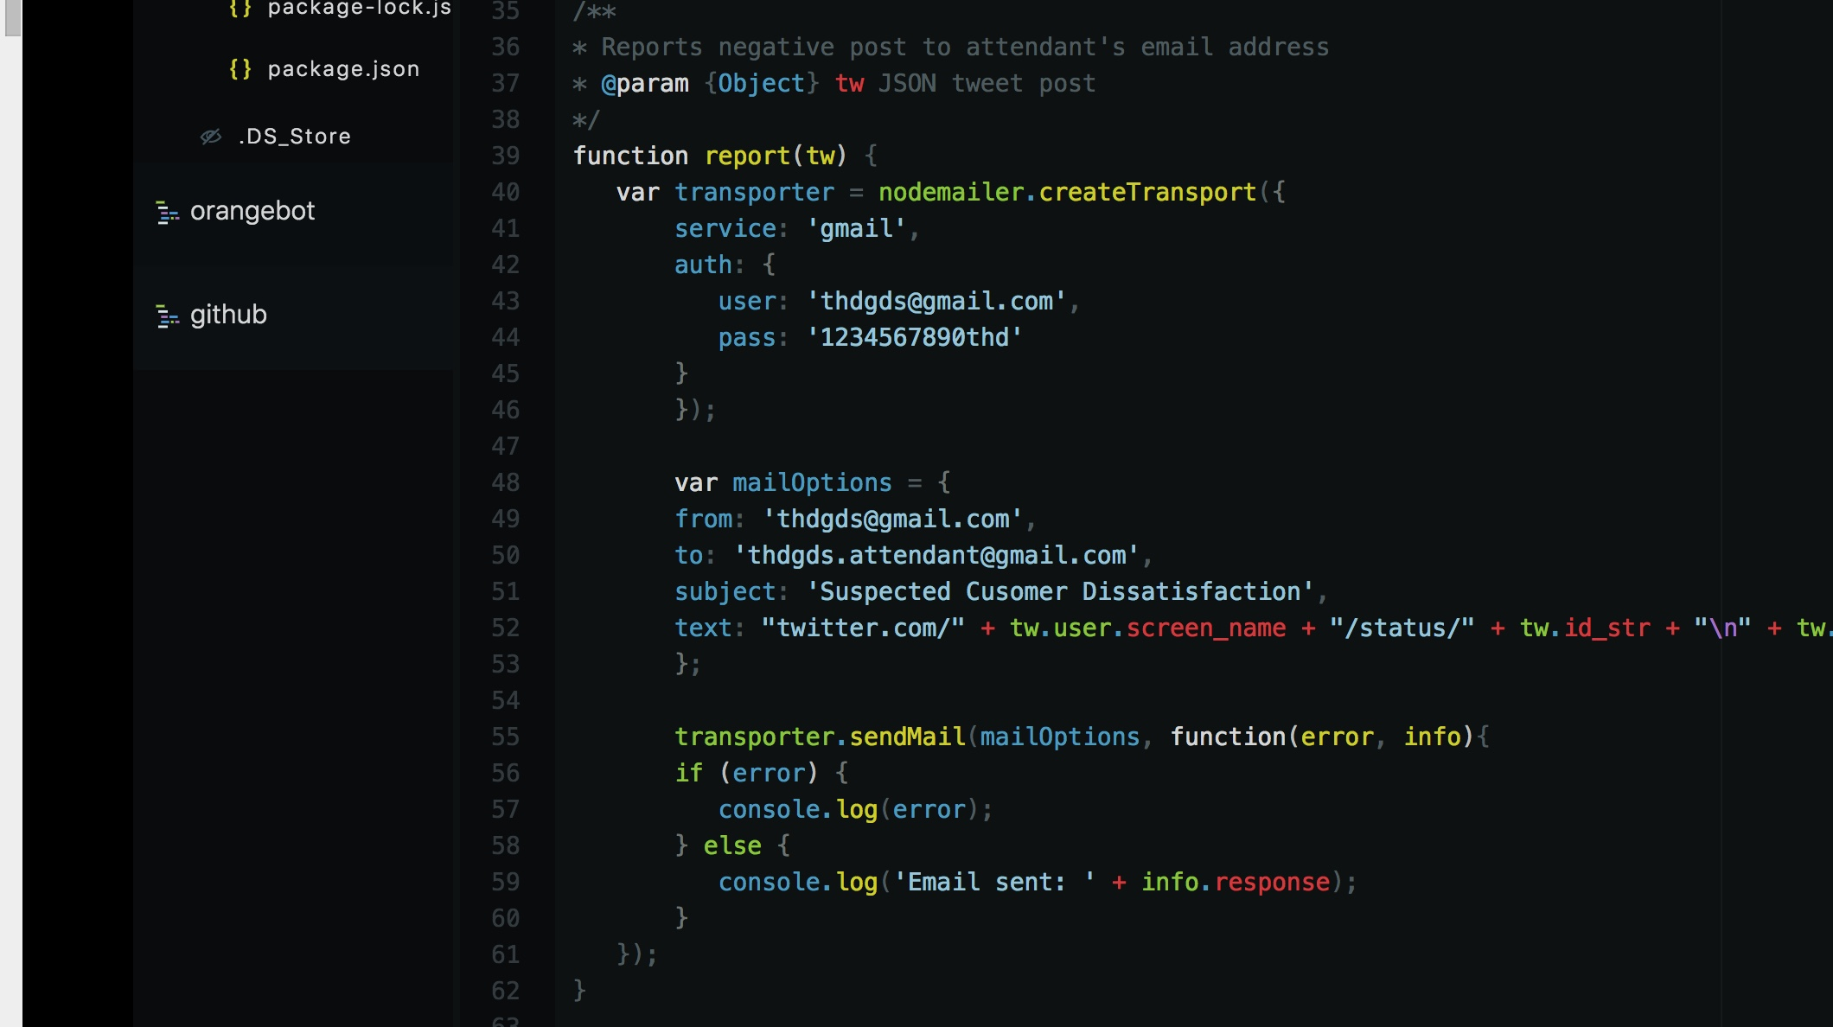
Node Mailer is a module for node.js apps that allows email sending

Slide 12
Benefits of Orange Bot
Narrows down the amount of tweets needed to be checked (time efficient)
Allows for better interaction with customers
Provides a better response
Provides assistance to unsatisfied customers by directing them to an employee
Allows Home Depot to monitor customer service and responds to their customer needs
Enables Home Depot to notify management at specific store locations to improve customer service
Cost Efficient
Saves money on labor costs, using an AI compared to paying workers

Slide 13
Resources
Twitter API
IBM Watson Tone Analyzer
Nodemailer API
Twitter account
Two email accounts (one for the bot, one for the Home Depot attendant)

